Slide 1
Announcements
New quiz on texture mapping, due before Friday Class
Friday Class at 4:00 PM
Meeting for students with difficulty at 3:30 PM Thursday in Hardware Lab will have Teams access for remote students.

Slide 2
Conceptual GPU data flow diagram
per-vertex
data
Vertex
Shader
program
Scan conversion
and variable
data interpolation
transformed
per-vertex data
fragments with
per-fragment data
texel address
Fragment
Shader
program
Texture
Memory
texel
data
Bilinear
texture
interpolation
data from
4 texels
pixel address
Active
Frame
Buffer
RGBA color
RGBA
Compositing
and
Depth Test
depth
depth
Depth
Buffer

Slide 3
Linear interpolation in 1D: y = m x + b
Given two values x1 and x2 and their corresponding y values y1 and y2, find the linear equation y = f(x) = m x + b, so that f(x1) = y1 and f(x2) = y2.
a) Use the two-point formula to determine m and b, as in lecture 1.
b) Solve the simultaneous linear equations f(x1) = y1 and f(x2) = y2 for the two unknowns m and b:
x1 m + b = y1
x2 m + b = y2
c) Define two basis functions: f1(x) with f1(x1) = 1 and f1(x2) = 0, and f2(x) with f2(x1) = 0 and f2(x2) = 1, and then define
f(x) = f1(x) y1 + f2(x) y2

Slide 4
c) Define two basis functions: f1(x) with f1(x1) = 1 and f1(x2) = 0, and f2(x) with f2(x1) = 0 and f2(x2) = 1, and then define f(x) = y1 f1(x) + y2 f2(x).
Y
y2
P2 = (x2, y2)
1
y2
y1
P1 = (x1, y1)
y1
X
x1
x2

Slide 5
c) Define two basis functions: f1(x) with f1(x1) = 1 and f1(x2) = 0, and f2(x) with f2(x1) = 0 and f2(x2) = 1, and then define f(x) = y1 f1(x) + y2 f2(x).
Y
The light blue line is the graph of f1(x).
y2
P2 = (x2, y2)
1
y2
y1
P1 = (x1, y1)
y1
f1(x)
X
x1
x2

Slide 6
c) Define two basis functions: f1(x) with f1(x1) = 1 and f1(x2) = 0, and f2(x) with f2(x1) = 0 and f2(x2) = 1, and then define f(x) = y1 f1(x) + y2 f2(x).
Y
The light blue line is the graph of f1(x). The dark blue line is the graph of y1 f1(x), with value y1 at x = x1, and value 0 at x = x2.
y2
P2 = (x2, y2)
1
y2
y1
y1
f1(x)
y1 f1(x)
X
x1
x2

Slide 7
c) Define two basis functions: f1(x) with f1(x1) = 1 and f1(x2) = 0, and f2(x) with f2(x1) = 0 and f2(x2) = 1, and then define f(x) = y1 f1(x) + y2 f2(x).
Y
The light blue line is the graph of f1(x). The dark blue line is the graph of y1 f1(x), with value y1 at x = x1, and value 0 at x = x2. The light green line is the graph of f2(x).
y2
P2 = (x2, y2)
1
y2
y1
f2(x)
y1
f1(x)
y1 f1(x)
X
x1
x2

Slide 8
c) Define two basis functions: f1(x) with f1(x1) = 1 and f1(x2) = 0, and f2(x) with f2(x1) = 0 and f2(x2) = 1, and then define f(x) = y1 f1(x) + y2 f2(x).
Y
The light blue line is the graph of f1(x). The dark blue line is the graph of y1 f1(x), with value y1 at x = x1, and value 0 at x = x2. The light green line is the graph of f2(x). The dark green line is the graph of y2 f2(x), with value y2 at z2 and value 0 at x1.
y2
P2 = (x2, y2)
1
y2 f2(x)
y2
y1
f2(x)
y1
f1(x)
y1 f1(x)
X
x1
x2

Slide 9
c) Define two basis functions: f1(x) with f1(x1) = 1 and f1(x2) = 0, and f2(x) with f2(x1) = 0 and f2(x2) = 1, and then define f(x) = y1 f1(x) + y2 f2(x).
Y
The dark blue line is the graph of y1 f1(x), with value y1 at x = x1, and value 0 at x = x2. The dark green line is the graph of y2 f2(x), with value y2 at z2 and value 0 at x1.
y2
P2 = (x2, y2)
1
y2 f2(x)
y2
y1
y1
y1 f1(x)
X
x1
x2

Slide 10
c) Define two basis functions: f1(x) with f1(x1) = 1 and f1(x2) = 0, and f2(x) with f2(x1) = 0 and f2(x2) = 1, and then define f(x) = y1 f1(x) + y2 f2(x).
Y
The dark blue line is the graph of y1 f1(x), with value y1 at x = x1, and value 0 at x = x2. The dark green line is the graph of y2 f2(x), with value y2 at z2 and value 0 at x1.
y2
P2 = (x2, y2)
1
y1 f1(x)
y2 f2(x)
y2
y1
y1
y1 f1(x)
X
x1
x
x2

Slide 11
c) Define two basis functions: f1(x) with f1(x1) = 1 and f1(x2) = 0, and f2(x) with f2(x1) = 0 and f2(x2) = 1, and then define f(x) = y1 f1(x) + y2 f2(x).
Y
The dark blue line is the graph of y1 f1(x), with value y1 at x = x1, and value 0 at x = x2. The dark green line is the graph of y2 f2(x), with value y2 at z2 and value 0 at x1. At any point x, the blue height and the green height add up to the height of the black line f(x).
y2
P2 = (x2, y2)
1
y1 f1(x)
y2 f2(x)
y2
y1
y1
y1 f1(x)
X
x1
x
x2

Slide 12
c) Define two basis functions: f1(x) with f1(x1) = 1 and f1(x2) = 0, and f2(x) with f2(x1) = 0 and f2(x2) = 1, and then define f(x) = y1 f1(x) + y2 f2(x).
Y
At any point x, the blue height and the green height add up to the height of the black line f(x) = y1 f1(x) + y2 f2(x). The black line passes through P1 and P2 since
f(x1) = y1*1 + y2*0 = y1,
f(x2) = y1*0 + y2*1 = y2.
y2
P2 = (x2, y2)
1
y1 f1(x)
y2 f2(x)
y2
y1
P1 = (x1, y1)
y1
y1 f1(x)
X
x1
x
x2

Slide 13
Linear interpolation in 2D: z = a x + b y + c
Given three 2D points (x1, y1), (x2, y2) and (x3, y3) and their corresponding z values z1, z2, and z3, find the linear equation function f(x, y) = a x + b y + c, with f(x1, y1) = z1, f(x2, y2) = z2 and f(x3, y3) = z3.
(x3, y3, z3)
Z
z3
(x1, y1, z1)
(x2, y2, z2)
Y
z2
z1
(x3, y3)
(x1, y1)
(x2, y2)
X

Slide 14
Linear interpolation in 2D: z = a x + b y + c
The plane of the blue triangle defines a linear function z = a x + b y + c on the whole XY plane. When x = y = 0, z = c, the Z intercept. In the XZ plane where y = 0, z = a x + c, so a is the slope of the green line.
(x3, y3, z3)
Z
z3
(x1, y1, z1)
(x2, y2, z2)
Y
z2
z1
(x3, y3)
(0, 0, c)
(x1, y1)
c
(x2, y2)
X

Slide 15
Linear interpolation in 2D: z = a x + b y + c
The plane of the blue triangle defines a linear function z = a x + b y + c on the whole XY plane. Similarly, b is the slope of the orange line in the YZ plane.
(x3, y3, z3)
Z
z3
(x1, y1, z1)
(x2, y2, z2)
Y
z2
z1
(x3, y3)
(0, 0, c)
(x1, y1)
c
(x2, y2)
X

Slide 16
Linear interpolation in 2D: z = a x + b y + c
Given three 2D points (x1, y1), (x2, y2) and (x3, y3) and their corresponding z values z1, z2, and z3, find the linear equation function f(x, y) = a x + b y + c, so that f(x1, y1) = z1, f(x2, y2) = z2 and f(x3, y3) = z3.
a) Solve the three simultaneous linear equations f(x1, y1) = z1, f(x2, y2) = z2, and f(x3, y3) = y3 for the three unknowns a, b, and c:
x1 a + y1 b + c = z1
x2 a + y2 b + c = z2
x3 a + y3 b + c = z3
b) Define three basis functions: f1(x, y) with f1(x1, y1) = 1, f1(x2, y2) = 0, and f1(x3, y3) = 0, f2(x, y) with f2(x1, y1) = 0, f2(x2, y2) = 1, and f2(x3, y3) = 0, and f3(x, y) with f3(x1, y1) = 0, f3(X2, Y2) = 0, and f3(x3, y3) = 1. Then define
f(x,y) = f1(x,y) z1 + f2(x, y) z2 + f3(x, y) z3

Slide 17
Solve the three simultaneous linear equations f(x1, y1) = z1, f(x2, y2) = z2, and f(x3, y3) = y3 for the three unknowns a, b, and c:
x1 a + y1 b + c = z1
x2 a + y2 b + c = z2
x3 a + y3 b + c = z3
This can be written as a matrix equation and solved by Cramer’s rule.
x1 y1 1 a z1
x2 y2 1 b = z2
x3 y3 1 c z3

Slide 18
Functions f1(x, y), f2(x, y) and f3(x, y) are called the barycentric coordinates of the point P(x, y) in Δ P1 P2 P3. Once they are determined, by computing a1, b1, c1, a2, b2, c2, a3, b3, and c3, these functions can be used to interpolate any linear function on Δ P1 P2 P3, like color components r, g, b, and a, depth z, or texture coordinates s and t. Since
f1(x, y) + f2(x, y) + f3(x, y) = 0 x + 0 y + 1 = 1
a1 + a2 + a3 = 0
a3 = 0 – a1 – a2
b3 = 0 – b1 – b2
c3 = 1 – c1 – c2
So only the 6 numbers a1, a2, b1, b2, c1, and c2 need be computed from the formulas on the previous slides.

Slide 19
Compute interpolation function z(x, y) for each pixel:
i_top = floor(top_y - .5);
for (y = i_top + .5; y > bottom_y; y = y - 1) {
xleft = f_left(y);
xright = f_right(y);
i_left = ceil(xleft - .5);
for (x = i_left + .5; x < xright; x = x + 1) {
f1 = a1*x + b1*y + c1; // f1, f2, and f3 can be reused
f2 = a2*x + b2*y + c2; // for r, g, b, and a
f3 = a3*x + b3*y + c3;
z = f1*z1 + f2*z2 + f3*z3; // 3 multiplies and 2 adds
set_pixel ((int)floor(x), (int)floor(y), r, g, b, a, z);
}
}

Slide 20
Less arithmetic for each pixel:
f1 = a1*x + b1*y + c1
f2 = a2*x + b2*y + c2
f3 = a3*x + b3*y + c3
z = f1*z1 + f2*z2 + f3*z3
z = (a1*z1 + a2*z2 + a3*z3)*x +
(b1*z1 + b2*z2 + b3*z3)*y +
c1*z1 + c2*z2 + c3*z3
= a*x + b*y + c
Then for the next pixel center (x+1, y), z = z + a

Slide 21
Less arithmetic for each pixel:
aa = a1*z1 + a2*z2 + a3*z3;
bb = b1*z1 + b2*z2 + b3*z3
cc = c1*z1 + c2*z2 + c3*z3;
for (y = i_top + .5; y > bottom_y; y = y - 1) {
xleft = f_left(y);
xright = f_right(y);
i_left = ceil(xleft - .5);
z = aa*(ileft + .5) + bb*y + cc;
for (x = i_left + .5; x < xright; x = x + 1) {
set_pixel ((int)floor(x), (int)floor(y), r, g, b, a, z);
z += aa; // one addition per pixel in inner loop over x
}
}

Slide 22
Alternative: linear interpolation in two 1D steps
Step 1, in outer loop on y: For a scan line at y in the XY plane, parallel to the X axis, interpolate both x and z as functions of y along the left and right sides of the black triangle, to get xl, xr, zl, and zr.
Z
(xr, y, zr)
(xl, y, zl)
z3
zr
Y
zl
z2
z1
(x3, y3)
(xl, y)
(xr, y)
(x1, y1)
(x2, y2)
X

Slide 23
Linear interpolation in 2D: z = a x + b y + c
For a scan line at y in the XY plane, parallel to the X axis, the vertical plane y = 0 intersects the blue plane in a line lying in that blue plane. So we can interpolate z as a function of x between zl and zr to pixel centers (x, y) along that line.
Z
(xr, y, zr)
(xl, y, zl)
z3
zr
Y
zl
z2
z1
(x3, y3)
(xl, y)
(xr, y)
(x1, y1)
(x2, y2)
X

Slide 24
Linear interpolation in 2D: z = a x + b y + c
For a scan line at y in the XY plane, parallel to the X axis, the vertical plane y = 0 intersects the blue plane in a line lying in that blue plane. So we can interpolate z as a function of x between zl and zr to pixel centers (x, y) along that line.
Z
(xr, y, zr)
(xl, y, zl)
z3
(x, y, z)
zr
Y
z
zl
z2
z1
(x3, y3)
(xl, y)
(x, y)
(xr, y)
(x1, y1)
(x2, y2)
X

Slide 25
Linear interpolation in 2D: z = a x + b y + c
We can interpolate z as a function of x to pixel centers (x, y) along that line.
We can similarly interpolate any other linear function, like the opacity a.
A
(xr, y, ar)
(xl, y, al)
a3
(x, y, a)
ar
Y
a
al
a2
a1
(x3, y3)
(xl, y)
(x, y)
(xr, y)
(x1, y1)
(x2, y2)
X

Slide 26
Alternative: First interpolate z in 1D along two edges
i_top = floor(top_y - .5);
for (y = i_top + .5; y > bottom_y; y = y - 1) {
xleft = f_left(y);
xright = f_right(y);
i_left = ceil(xleft - .5);
zleft = f_z_left(y);
zright = f_z_right(y);
...
}

Slide 27
Then interpolate z in 1D along each scan line
for (y = i_top + .5; y > bottom_y; y = y - 1) {
xleft = f_left(y);
xright = f_right(y);
i_left = ceil(xleft - .5);
zleft = f_z_left(y);
zright = f_z_right(y);
m_z = (zright – zleft) / (xleft – xright);
z = zleft + m_z*(ileft + .5 – xleft); // first z
for (x = i_left + .5; x < xright; x = x + 1) {
set_pixel ((int)floor(x), (int)floor(y), rz);
z += m_z; // one addition per pixel to update z
}
}

Slide 28
Clipping to avoid generating off-screen fragments
Replace this triangle
screen window

Slide 29
Clipping to avoid generating off-screen fragments
Replace this triangle by
this more complicated
polygon.
screen window

Slide 30
Sutherland-Hodgeman 2D polygon clipping
Think of a polygon as an ordered list of vertices
From this input list create an output list accounting for clipping against an edge E of the screen window.
Each polygon edge has an old vertex O and a new vertex N.

Slide 31
Clipping polygon edge ON with window edge E
N
If O and N are both on the window side of edge E, put N in the output list of vertices.
edge E
O

Slide 32
Clipping polygon edge ON with window edge E
If O is inside and N is outside, find the intersection I of ON and E, interpolate attributes like r, g, b, a, z, s, and t to point I in 1D along edge ON, and add I to the output list.
edge E
O
I
N

Slide 33
Clipping to avoid generating off-screen fragments
Replace this triangle by
this more complicated
polygon. Divide it by
horizontal lines through
its vertices into polygons
with one left edge and one
right edge. Scan covert
each such polygon.
screen window

Slide 34
Similarly, when dividing a general triangle in two by a horizontal line, interpolate the attributes to Qmiddle.
Draw a horizontal line though Pmiddle, which intersects edge Ptop Pbottom at Qmiddle.
Interpolate the attributes at Ptop and Pbottom to Qmiddle along the edge Ptop Pbottom.
Ptop
Pmiddle
Qmiddle
Pbottom

Slide 35
Data in RevisedGeometryTriangles.cpp, with no horizontal or vertical edges
int triangles[5][3] = {
{0, 1, 2}, // ABC
{0, 3, 1}, // ADB
{1, 4, 2}, // BEC
{0, 2, 5}, // ACF
{0, 3, 6} // ADG
};
double vertices[8][2] = {
{60.5, 175.5}, // A 0
{224.5, 325.5}, // B 1
{374.5, 190.5}, // C 2
{74.5, 285.5}, // D 3
{350.5, 300.5}, // E 3
{150., 100.}, // F 5
{ 25., 125.}, // G 6
{0., 0.} // Q 7
};

Slide 36

The are bright pixels that are composited twice. Why?

Slide 37
void draw_horizontal_edge_triangle(int i1, int i2, int i3, int kind) {
double m_left, b_left, m_right, b_right, x, y, top_y, bottom_y, xleft, xright;
int i_top, i_left, db_horizontal = 0, db_double = 0, bad;
if (kind) { // top vertex i1 belongs to both non-horizontal edges
if (vertices[i2][0] < vertices[i3][0]) { // vertex i2 is on the left
get_x_line_equation(i1, i2, m_left, b_left);
get_x_line_equation(i1, i3, m_right, b_right);
}
else { // vertex i3 is on the left
get_x_line_equation(i1, i3, m_left, b_left);
get_x_line_equation(i1, i2, m_right, b_right);
}
}
else { // bottom vertex i3 is on both both non-horizontal edges
if (vertices[i1][0] < vertices[i2][0]) { // vertex i1 is on the left
get_x_line_equation(i1, i3, m_left, b_left);
get_x_line_equation(i2, i3, m_right, b_right);
}
else { // vertex i2 is on the left
get_x_line_equation(i2, i3, m_left, b_left);
get_x_line_equation(i1, i3, m_right, b_right);
}
}

Slide 38
i_top = floor(top_y - .5);
if (i_top > height - 1)
i_top = height - 1;
if (bottom_y < 0)
bottom_y = 0;
for (y = i_top + .5; y > bottom_y; y -= 1) {
xleft = m_left*y + b_left;
xright = m_right*y + b_right;
i_left = ceil(xleft - .5);
if (i_left < 0)
i_left = 0;
if (xright > width)
xright = width;
for (x = i_left + .5; x < xright; x += 1) {
set_pixel_alpha((int)floor(x), (int)floor(y),
color[0], color[1], color[2], color[3], a);
}
}

Slide 39
i_top = floor(top_y - .5);
for (y = i_top + .5; y > bottom_y; y -= 1) {
xleft = m_left*y + b_left;
xright = m_right*y + b_right;
i_left = ceil(xleft - .5);
zleft = m_z_left*y + b_z_left;
zright = m_z_right*y + b_z_right;
m_z = (zright – zleft) / (xleft – xright);
z = zleft + m_z*(ileft + .5 – xleft); // first z
for (x = i_left + .5; x < xright; x = x + 1) {
set_pixel ((int)floor(x), (int)floor(y), r, g, b, a, z);
z += m_z; // one addition per pixel to update z
}
}
// you need to interpolate r, g, b, and a similarly

Slide 40
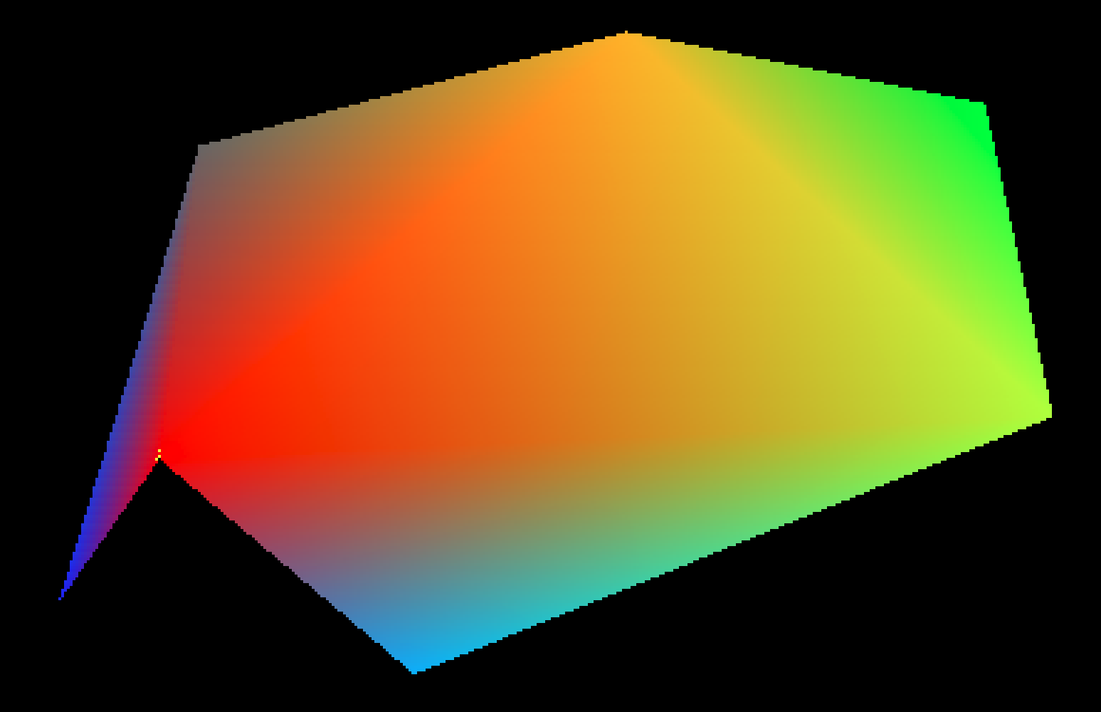

Slide 41
Z Buffer test:
If z of the new fragment is nearer than the current value in the B buffer, then update the pixel color and the depth value in the Z Buffer. Otherwise, the new fragment is hidden by a nearer surface, so do nothing.
In the right-handed WebGL coordinate system the Z axis points toward the view, so nearer means larger z.
Y
X
Z

Slide 42
double Zbuffer[width][height];
void set_pixel_alpha(int x, int y, double r, double g, double b, double a, double z) {
int index;
float transparency = 1 - a;
if (x >= 0 && x < width && y >= 0 && y < height && z >= ZBuffer[x][y]) {
ZBuffer[x][y] = z;
index = 3*(x + width*y);
image[index ] = (unsigned char) (255*a*r +
transparency*(float) image[index ]);
image[index+1] = (unsigned char) (255*a*g +
transparency*(float) image[index+1]);
image[index+2] = (unsigned char) (255*a*b +
transparency*(float) image[index+2]);
}
}
}

Slide 43
Data in ShadedTriangleData.cpp in
Source files for Homework 4
int triangles[7][3] = {
{0, 1, 2}, // ABC
{0, 3, 1}, // ADB
{1, 4, 2}, // BEC
{0, 2, 5}, // ACF
{0, 3, 6}, // ADG
{7, 8, 9}, // HIJ
{10, 11, 12} // KLM
};

Slide 44
double vertices[14][3] = {
{60.5, 175.5, 1.}, // A 0
{224.5, 325.5, 2.}, // B 1
{374.5, 190.5, 5.}, // C 2
{74.5, 285.5, 4.}, // D 3
{350.5, 300.5, 6.}, // E 3
{150., 100., 3.}, // F 5
{ 25., 125., 8.}, // G 6
{450., 120., -2.}, // H 7
{445., 350., -2.}, // I 8
{100., 260., 9.}, // J 9
{20., 90., 10.}, // K 10
{189., 95., 10.}, // L 11
{102., 350., 1.}, // M 12
{0., 0., 0.} // Q 13
};

Slide 45
double colors[14][4] = {
{1., 0., 0., 1.}, // A 0
{1., .7, 0., 1.}, // B 1
{.7, 1., 0., 1.}, // C 2
{.4, .4, .4, 1.}, // D 3
{0., 1., 0., 1.}, // E 4
{0., .7, 1., 1.}, // F 5
{0., .2, 1., 1.}, // G 6
{0., 1., 1., 1.}, // H 7
{0., .7, .7, 1.}, // I 8
{0., 1., 1., 1.}, // J 9
{1., 0., 1., .5}, // K 10
{1., 0., 1., .5}, // L 11
{1., 0., 1., .5}, // M 12
{0., 0., 0., 0.}, // Q 13
};

Slide 46
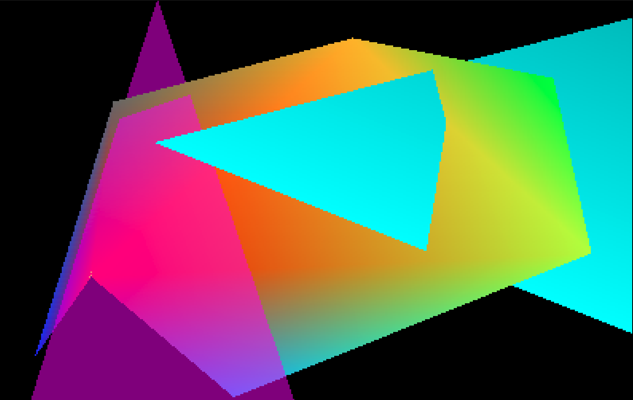

Slide 47
Transparency works here because the single transparent triangle KLM was last in the list of triangles, so it could be composited correctly over all the opaque triangles that are behind it. If there are multiple transparent surfaces, they must be composited in back to front order, so that any triangle is correctly composited in front of any surfaces that should appear behind it.

Slide 48
Transparency works here because the single transparent triangle KLM was last in the list of triangles, so it could be composited correctly over all the opaque triangles that are behind it. If there are multiple transparent surfaces, they must be composited in back to front order, so that any triangle is correctly composited in front of any surfaces that should appear behind it. The blue square is at the back, the green triangle is in the middle, and the red square is in the front. On the left, they are rendered in that order. But on the right, they are rendered in the order blue, red, and green, and the tip of the green triangle is cut off by the depth test.

